Slide 1
DevSecOps Best Practices Guide Content
DRAFT
January 2020

Slide 2
Introduction
Application development programs leverage Agile and DevOps software development methodologies to support the continuous integration and continuous delivery required for their business solutions.
At the same time, systems continue to be a primary target for bad actors due to the sensitive nature of mission data.
DevSecOps accelerates delivery by automating the required security and privacy processes for threat modeling, generating security and privacy documentation artifacts, change and source control management, static and dynamic code analysis, infrastructure hardening and least functionality checks.
This DevSecOps research proposes best practices (e.g., standards, processes, and technologies) to ensure that trusted applications and solutions are securely developed and continuously delivered to end users…

Slide 3
DevSecOps Best Practices
Security Validation as Code - Testing standards, testing content (code), and automation tools to effectively know “is it secure?”
Documentation as Code - Testing standards, testing content (code), and automation tools to effectively know “how am I secure?” to help maintain System Security Plan (SSP) documentation.
Change Management Auditing - Processes to foresee significant security testing changes in a Sprint (Security Impact Analysis), and pipeline auditing to track unauthorized changes during builds. Answers the question: “what changed?”
Reporting – Reporting and integration requirements to comply with stakeholder use of security data from the DevSecOps lifecycle. Stakeholders include: developers, ISSOs, Security Assessors, security operations center staff, and FISMA reporting teams.
Operational Analytics – Best practice process to engineer application audit log triggers during development to detect anomalies during operations and use this data to adapt to and plan for the next application development Sprint.
DevSecOps Process Improvement – Describes what to measure and how to analyze the data to constantly improve the project’s DevSecOps process. Improve future builds using metrics and measures of security debt, unauthorized changes during development, and detection of anomalies during operation.

Slide 4
Value of Building Security into DevOps
For the Business Owner:
Projects will have a streamlined development pipeline for delivering trusted services to end users.
For the Developer:
Empower the developer to reduce the security defect debt, sprint-to-sprint
For the ISSO:
Enable the ISSO to always know their security posture
For Security governance:
Use DevOps pipeline to automatically generate security testing data
Security controls and testing are embedded within the development pipeline and results in faster delivery of secure solutions
Consistency and transparency in the way tests are performed
provide a library the specific tests to be used
Consistency and consolidation of the results from those tests
approve the format of results, for consistency across all environments
Lay a foundation for moving to ongoing authorization decisions

Slide 5
Benefits of Building Security into DevOps
Developer:
Higher security assurance, at all times, of the security of their code as well as the supporting stack
Lower security debt (i.e., higher security defect remediation rates)
ISSO:
Always aware of security status
Faster security go-live decisions during sprints
Timely, clear, concise, consolidated, trusted security data
Clear understanding of which security controls are either directly supported or validated as in place
Business Owner:
Reduced Security Control Assessment testing time/cost, by using DevOps security data
Moves organization to ongoing authorization to reduce time/cost
Use change management auditing data to perform business analytics for non-security use cases to improve (e.g., sprint planning efficiency)
Security governance:
Trust in the security tests and results

Slide 6
Building Security into DevOps Preventing vulnerable applications from reaching production, sprint to sprint
Why?
The faster deployments that are also part of DevOps, while appealing:
can also lead to faster deployments of vulnerable applications…
leading to higher risk of unauthorized access to sensitive data
Challenges for the:
ISSO: to track changes and weigh security at the end of each sprint
Developer: to receive timely, concise security defect information each time they code and build
What needs to change?
At the end of each sprint, the ISSO and developer need to:
have confidence that the application about to be deployed is secure
make an informed security go-live decision at the end of each sprint
To do this, they need timely security data, lots of it, of various kinds and prepared/consolidated in specific ways…

Slide 7
Shifting Security Left
“Shifting Security to the Left” Earlier detection, cheaper to fix.
Reduced analysis time for root cause of security defects
Vulnerability Scanning
Configuration Settings Compliance
Least Functionality
Static
Dynamic
Commit
Build
Unit Test
Deploy
Test
Prod Deploy
Continuous Integration
Approval
Continuous Delivery
Approval
Continuous Deployment
Notes:
The simple message of this slide is that DevSecOps shifts security left, earlier in the lifecycle when it is cheaper to fix and avoids unnecessary delays

Slide 8
The DevSecOps Checklist
| 8 |
This is a checklist to include Security into DevOps pipelines/processes.
It assumes a DevOps environment with a fully automated CI/CD pipeline, and no manual user interaction beyond committing software into the repository.
Goal: Maintain security debt at a consistent level, Sprint to Sprint, by enabling developers, ISSOs to verify security and compliance early and often during each Sprint.
Automation and standardization of this security data is essential.
Does the pipeline automatically validate, at each create and configure for each build, security configuration settings compliance of underlying application stack components? Evaluates supporting cloud, network, operating system, database, app-server and web-server components’ configurations against STIGs, CIS Benchmarks and CCE compliance.
Does the pipeline automatically validate, at each create and configure for each build, security vulnerability levels of underlying application stack components? Assesses software patch levels and CVE compliance.
Does the pipeline automatically validate, at each create and configure for each build, least functionality of underlying application stack components? Limits services, ports and protocols for application stack to function, compliant with NIST SP 800-53 CM-7 Least Functionality requirements.
Does the pipeline automatically perform static code analysis, at each commit, against application source code. Analyze at least 95% of the lines of code (95% code coverage) and perform linting checks for security issues against, at a minimum, SANS Top 25 CWE compliance.
Does the pipeline automatically perform dynamic code analysis, at each create and configure for each build, against application compiled/running code Assesses code security against, at a minimum, OWASP Top 10 CWE.
Does the pipeline automatically generate all of the above security data in the standard “Heimdall Data Format” for machine-readability, assigning severity levels to each security test result (high, medium, low) and mapping all security test results to NIST SP 800-53 security controls? Ensure compliance with InSpec JSON output reporter schema including, at a minimum, these labels: title, description, check text, fix text, relevant NIST SP 800-53 tags and impact level for each defect.
Does the pipeline automatically track and compare planned versus executed changes, to prove that planned changes, and *only* the planned changes, were implemented during a Sprint?
Do developers, ISSOs certify that all high security defects and 90% of all medium or low security defects are resolved before allowing affected functionality to be deployed to production?
Do developers and ISSOs assure that no security defect may carry-over unresolved through more than 2 Sprints?
10. Are unplanned (unauthorized) changes for any Sprint less than 5% of planned (authorized) changes?

Slide 9
Checklist Cross-walk: Sprint Days 1 - 2
| 9 |
ISSO works with Developers and DevOps team to:
Identify all proposed functional changes (e.g., in project issue tracker)
Identify additional security testing required, for example, new/changed:
Code to add to scope of static code analysis tests
APIs, web forms, web pages to add to scope of dynamic analysis tests
Cloud, network, operating system, database, app-server and web-server components to add to scope of security configuration setting, patchable vulnerability, and least functionality tests
Document the above in a draft Sprint Security Impact Analysis (SIA)
7.
4.
5.
1.
2.
3.
7.

Slide 10
Checklist Cross-walk: Sprint Days 3 - 8
| 10 |
Developers use the DevOps pipeline to help:
At each commit: automatically perform static code analysis against application source code
At each create and configure for each build, automatically validate:
security configuration settings compliance,
security vulnerability levels, and
least functionality of underlying application stack components
At each create and configure for each build: automatically perform dynamic code analysis, against application compiled/running code
Resolves all high security defects and 90% of all medium or low security defects detected by the pipeline during the Sprint
4.
1.
2.
3.
5.
8.

Slide 11
Checklist Cross-walk: Sprint Days 9 - 10
| 11 |
The ISSO works with the Developers to review logs from the DevOps pipeline:
To compare executed changes to the planned changes documented in the Draft SIA and verify that planned changes, and *only* the planned changes, were implemented during a Sprint
If the unplanned changes were not covered by security testing, the ISSO recommends the affected functionality be held back from production deployment until security testing can be performed
The ISSO and Developers work to ensure that unplanned (unauthorized) changes for any Sprint is less than 5% of planned (authorized) changes
The ISSO reviews final-run security testing results to verify that all high security defects and 90% of all medium or low security defects are resolved before allowing affected functionality to be deployed to production
Developers and ISSOs assure that no security defect may carry-over unresolved through more than 2 Sprints
7.
7.
10.
8.
9.

Slide 12
Security Data needed for Developer/ISSO Sprint Go-Live
The data needed by the ISSO and developer can be grouped into 3 basic types:
“Is it secure?” – data at all levels of the application stack proving that no high impact security defects remain, about 90% of all remaining (non-high) impact security defects have been resolved, and each security defect is mapped to the relevant NIST SP 800-53 security control (for context), across the following areas:
Secure Configuration Settings (i.e., STIG or CIS Benchmarks against all supporting cloud, network, operating system, database, app-server, web-server components, checking for CCE defects)
Vulnerability Scanning (i.e., Patch Levels, checking for CVE defects)
Least Functionality (limit services, ports, protocols only for application to function, NIST SP 800-53 CM-7 Least Functionality defects)
Static Code Analysis (i.e., against application source code, checking for CWE defects)
Dynamic Code Analysis (i.e., against application compiled/running code, checking for CWE defects)
“How is it secure?” – data to supplement the System Security Plan to reflect the latest technical security system design
“What has changed during this Sprint?” – data that proves that the planned changes, and *only* the planned changes, were implemented during the Sprint

Slide 13
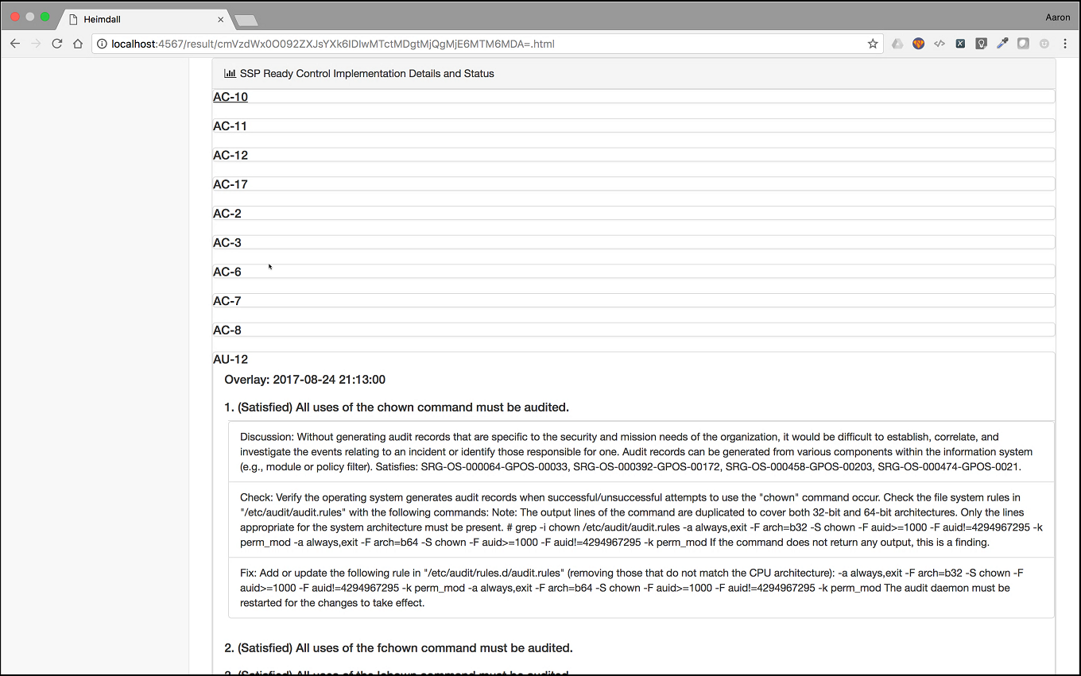
Security Data needed for Developer/ISSO Sprint Go-Live
How is it Secure?
(Artifacts for the SSP*)
Is it Secure?
What’s Changed?
(Architecture Changes for the SIA*)
* SSP – System Security Plan Documentation Suite
SIA – Security Impact Analysis, required for each sprint

Slide 14
Current DevSecOps Best Practice Focus Areas

Slide 15
User Stories Supported by Current DevSecOps Best Practice Areas
User Story / Pain Point: As a DevOps/Agile developer: | Best Practice Area
… it is cheaper and easier to fix security defects early in the development process. I need tools that are integrated into my CI/CD pipeline to help me assess and correct security defects on-demand, as I build, iteratively: to build, get immediate security defect feedback, determine root-cause, correct, and re-build many times a day… | Security Validation as Code (Is it secure?)
… and automatically document the as-built security in my system for my ISSO… | Security Documentation as Code (How is it secure?)
… and I need to account for all of my changes through the pipeline before requesting a security go-live decision for my system… | Change Management Auditing (What changed during this sprint?)

Slide 16
Security Data needed from the DevOps Pipeline
How can all this data possibly be provided every 2 weeks? Fortunately, DevOps pipelines embrace automation. Likewise, to provide timely data to developers and ISSOs, security must also embrace automation within the pipeline. The following figure illustrates the tests to be called by the pipeline to generate this security data automatically…

Slide 17


Automated Security Data needed from the DevOps Pipeline
What security data do the ISSO and developer need to make their sprint go-live decision?
Trusted, known tests, tailored to organizational requirements, results mapped NIST SP 800-53 controls, timely: at each code and build
Application Code
Static and Dynamic Code Analysis
SecurityData
Mapped
to
NIST SP
800-53
Controls
Developer
No high impact security defects
90% of all remaining security defects resolved
Validate approved changes
Web Server
Application Server
Least Functionality Checks (no extra services or ports)
ISSO
Database
SECURITY DATA
Containers
Vulnerability Scanning (up-to-date packages/patches)
What changed based on Pipeline Logs
Security go-live approval every sprint!
Operating Systems
Network Components
Secure Configuration Settings (e.g., STIG, CIS benchmarks)
Cloud Services
Code
Build
Tests (Called by Pipeline Itself!)
Approve
Deploy
(The DevOps 2-week Agile “sprint” Deployment Pipeline)

Slide 18
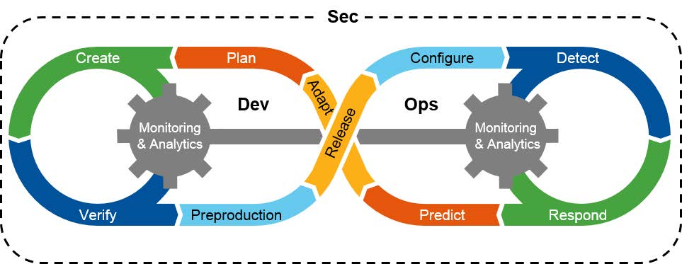
Security in DevOps - Current Focus Areas
Some Application teams have embraced the Gartner “infinity loop” DevOps cycle as a model for how teams should conduct development and operation of applications. The figure below illustrates how the current best practice focus areas support this model:
Security Documentation as Code
Change Management Auditing
Security Validation as Code
Original “Infinity Loop” Graphic Source: Gartner - DevSecOps

Slide 19
Security validation as code devsecops best practice focus area

Slide 20


Security Validation as Code
Testing Content
Testing Tools
Data Viewing Tools
Source Code Repository
Library of Tests
Mapping Tools
e.g., Heimdall
e.g., InSpec
Answers: Is it Secure?
“Security Validation as Code”
This focus area uses the pipeline to directly perform security validation tests.
The security defects produced by these tests need to either already map their defect results to NIST SP 800-53 security controls, or provide a category for the security defect that can easily be mapped to NIST SP 800-53 security controls automatically.

Slide 21










Automating Security Validation – Process to Procedures
| 21 |
Security
Validation
as Code
Execution
Security Testing Content Development
Data Mapping and Visualization Tools
https://github.com/mitre/vulcan
https://github.com/mitre/inspec_tools
https://github.com/mitre/ (*baseline)
Inspec_tools
System(s) Under
Evaluation
DISA STIG
Validation
Profiles
Master Nodes (3)
Validation
Results
https://mitre.github.io/heimdall-lite/
CIS Benchmarks
Ingest Nodes (X)
Automated Conversion
Human Code
Completion/Refinement
Data Nodes - Hot (X)
Vendor Security Checklist
https://github.com/mitre/heimdall_tools
Data Nodes - Warm (X)
Implementation
Guides
InSpec Engine
Static & Dynamic Code Analysis
https://github.com/mitre/heimdall
CCE, CVE, Least Functionality Tests
CWE Tests
Notes:
* This slide shows the process we're helping to transform from STIGS, to testing content, mapping security controls, and visualizing security compliance
* Heimdall is the all-seeing Norse god that appears in the Marvell movies – who's power is to see all that is happening everywhere
* MITRE developed the Heimdall applications to standardize the view into security data
* The Heimdall applications show security control compliance by ingesting the machine readable data generated using tools like inspec and heimdall_tools.

Slide 22
Open Source Applications, Tools and Libraries
| 22 |
Security Testing and Hardening Content:
https://GitHub.com/MITRE
STIG Creation Tools
https://GitHub.com/MITRE/vulcan
Security Testing Content Development Tools:
https://GitHub.com/MITRE/inspec_tools
Security Data Viewing Tools:
Heimdall Server https://GitHub.com/MITRE/heimdall
Heimdall-lite https://MITRE.GitHub.io/heimdall-lite/ and https://github.com/mitre/heimdall-vuetify
Security Data Conversion Tools:
https://GitHub.com/MITRE/heimdall_tools
Training Courses
https://mitre-inspec-developer.netlify.com/
https://mitre-inspec-advanced-developer.netlify.com/
Security Automation Community Repository Statistics on MITRE Github (https://www.github.com/mitre)
75 repositories on the MITRE Github
4700+ downloads on inspec_tools on RubyGems.org
400+ downloads on heimdall_tools on RubyGems.org
200 downloads/week on inspecjs on NPM.org
145 downloads/week on heimdall-lite on NPM.org and Docker Hub
3400 downloads on Heimdall Server on Docker Hub
600 downloads on Heimdall Server on Packager.io
inspec_toolsjs and heimdall_toolsjs coming soon
Notes:
As a recap, here are all the mainline tools that are under the CCA that you can use, review and lookover

Slide 23
Testing Tools for Security Validation as Code
To perform least functionality, patching, and configuration setting checks against the underlying infrastructure of cloud, network, operating system, container, database, application, and web server technologies supporting an application; an example of an accessible, open-source tool DevOps teams may choose is InSpec, a testing framework that can be incorporated into the existing testing harness of a pipeline’s orchestration server. InSpec is well-suited to performing concrete sets of tests against known infrastructure components supporting an application…

Slide 24

The Tech: using InSpec for Security Validation as Code
Testing Tools
Open Source – a growing community including NGA, NRO, USGCB, CMS, AOC, DISA
Built to integrate with any orchestration technology or testing harness
Small footprint – built for speed and simplicity
Intuitive validation language based on Ruby
Customizable with overlays and attribute exceptions
Developers and Security auditors can see the exact tests within the profile code
Human- and machine-readable output allows for desktop use and scalability to enterprise
Immediate feedback for the developer at their desktop
Dashboard integration for SIEM* or other tools for Sprint teams
Enterprise viewable by security auditors
Tests and Results are tagged/linked to NIST SP 800-53 controls
Can be used against any part of the application stack or infrastructure:
e.g., RHEL, NGINX, PostgreSQL, Docker, Apache, MySQL, Hadoop, AWS, etc.
* SIEM: Security Information and Event Management

Slide 25
Secure Config, Vulnerability, Least Functionality Checks with InSpec
Plan
Commit
Build
Unit Test
Deploy
Test
Production
Web Server
Orchestration Server used to Create, Configure, and Validate
Developer
Project Issue Tracking Tool
Create/Configure
Application Server
Commit
Source Code Repository
Job
Database
ISSO
Containers
Validate
Operating Systems
Validate
Security go-live approval every sprint!
Network Components
Security Validation as Code:
Cloud Services
Least Functionality Checks (no extra services or ports)
SecurityData
Mapped
to
NIST SP
800-53
Controls
Vulnerability Scanning (up-to-date packages/patches)
Secure Configuration Settings (e.g., STIG, CIS benchmarks)

Slide 26
Testing Content for Security Validation as Code
InSpec relies on testing content in the form of InSpec “profiles” to perform validation.
A library of approved profiles is expected to be available for all DevOps teams to use within their pipelines to validate the security of their underlying infrastructure, as often as needed, to reduce and maintain security debt.
The library as under development is shown on the next slide, and is expected to grow as application teams adopts different technologies to support their applications…

Slide 27
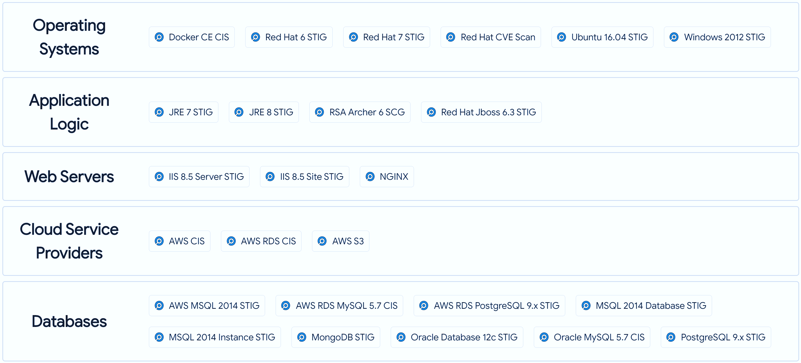
Current Testing Content: Library of InSpec Profiles
Testing Content
https://mitre-saf.netlify.com/validation

Slide 28
Security Control Context for InSpec tests
control "V-71921" do
title "The shadow file must be configured to store only encrypted
representations of passwords."
desc "Passwords need to be protected at all times, and encryption is the
standard method for protecting passwords. If passwords are not encrypted, they
can be plainly read (i.e., clear text) and easily compromised. Passwords
encrypted with a weak algorithm are no more protected than if they are kept in
plain text."
impact 0.5
tag "gtitle": "SRG-OS-000073-GPOS-00041"
tag "gid": "V-71921"
tag "rid": "SV-86545r1_rule"
tag "stig_id": "RHEL-07-010210"
tag "cci": ["CCI-000196"]
tag "documentable": false
tag "nist": ["IA-5 (1) (c)", "Rev_4"]
tag "check": "Verify the system's shadow file is configured to store only
encrypted representations of passwords. The strength of encryption that must be
used to hash passwords for all accounts is SHA512.
Check that the system is configured to create SHA512 hashed passwords with the
following command:
# grep -i encrypt /etc/login.defs
ENCRYPT_METHOD SHA512
…
When developing InSpec profiles, we ensure that each test has an associated NIST SP 800-53 tag.
When an InSpec profile is run against a target system, the security data output includes this tag as well as all other tags, description information and code for each test.
IA-5(1),
NIST SP 800-53’s Security Control for
Identification and Authentication - Password-based Authentication

Slide 29
Mapping Tools for Security Validation Data
To perform application code security validation, DevOps teams are adopting various static and dynamic code analysis tools. To help DevOps teams manage data from these tools, mapping algorithms and tools should be developed to ensure that the security defects found by commonly used static and dynamic code analysis tools are also mapped* to NIST SP 800-53 controls, and machine-readable and viewable in the same fashion other types of security data, such as InSpec output.
Static code analysis tools are typically expected to be called by the source code repository upon each major commit, and dynamic code analysis tools called by the existing testing harness of a pipeline’s orchestration server.
* An open source demonstration of a static and dynamic mapping tool is: https://github.com/mitre/heimdall_tools

Slide 30
Data Mapping Tools for Static & Dynamic Code Analysis Tool Output
Plan
Commit
Build
Unit Test
Deploy
Test
Production
Orchestration Server used to Create, Configure, and Validate
Developer
Project Issue Tracking Tool
Source Code Repository
Commit
Job
Compile/Configure
ISSO
Validate
Application Code
Static Analysis Security Tools
e.g., SonarQube
Dynamic Analysis Security Tools
e.g., OWASP ZAP
Security go-live approval every sprint!
Validate
Validate
Security Validation as Code
Mapping Tools
SecurityData
Mapped
to
NIST SP
800-53
Controls
Static and Dynamic Code Analysis

Slide 31
Data Viewing Tools for Security Validation Data (1/2)
In addition to ensuring the pipeline generates timely security data, we also require the data to be prepared in specific, consistent ways, to meet several goals:
Machine-readability - to ensure that the data can be moved and transformed as needed
Security control context - security defects tagged to NIST SP 800-53 controls, to provide a common point of reference for the security context of any defect
Transparency – shows not only the test code, but the reasoning behind it, all details of the security defects from the original testing profile or tool, and the explanation of how to fix the defect
Flexibility – allows viewing at the developer’s desktop from the command-line, or using a GUI to view on the developer’s laptop, DevOps team server or data center server
Consistency – allows for a familiar view for a wide audience: developers, ISSOs and Business Owners

Slide 32
Data Viewing Tools for Security Validation Data (2/2)
Machine-readability is important to allow security data to be transported to, easily read by, and presented on a customer’s preferred dashboard.
In addition to adopting a tool such as InSpec and developing mapping tools discussed earlier, DevOps teams should standardize on a tool such as the open-source Heimdall to view and analyze the machine-readable data produced by InSpec and mapping tools, and use security information and event management (SIEM) tools to move this data for team and enterprise (e.g., data center) viewing.
This helps the pipeline automatically generate all security data in a standard “Heimdall Data Format” for machine-readability, assigning severity levels to each security test result (high, medium, low) and mapping all security test results to NIST SP 800-53 security controls.
The output is standardized in a json format including a title, description, check text, fix text, relevant NIST SP 800-53 tag and impact level for each security defect.

Slide 33
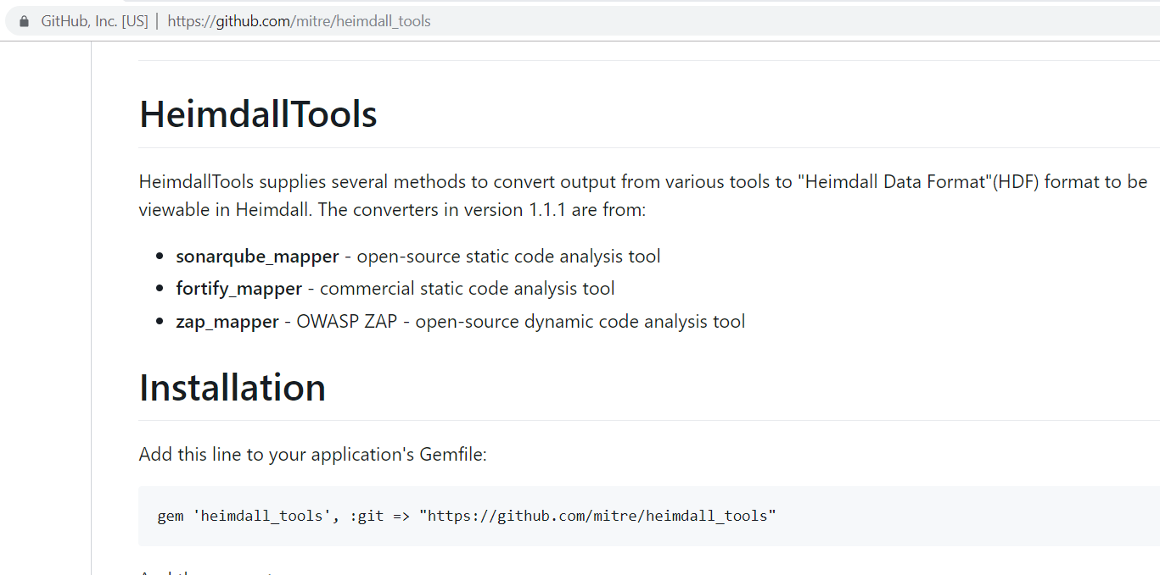
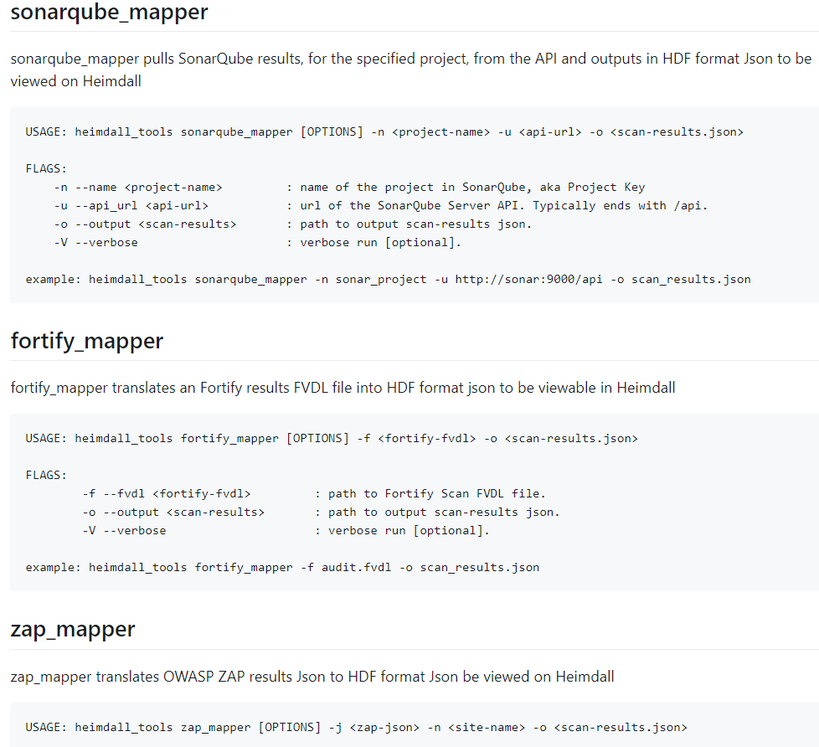
Mapping/Conversion Tools for Security Validation Data
See: https://GitHub.com/MITRE/heimdall_tools

Slide 34
Example Data Viewing Tools – using Heimdall + SIEM Tools
Source Code Repository
Orchestration Server used to Create, Configure, and Validate
InSpec Profile Library
Job
Data Viewing Tools
Static Analysis Security Tools
e.g., SonarQube
Dynamic Analysis Security Tools
e.g., OWASP ZAP
Validate
Developer
Upload via GUI
ISSO
Validate
Mapping Tools
Retrieve from storage
Heimdall-lite (local view)
DevOps Team
Security Data Mapped to NIST SP 800-53 Security Controls
Upload via GUI or API
Machine-readable
JSON
Files
Heimdall Server
(team/enterprise view)
Business Owner
SIEM Tools
… or Retrieve from SIEM

Slide 35
Heimdall Versions
Data Viewing Tools
DevOps teams should make should use technologies to make this data as accessible as possible for different use cases and stakeholders. This will allow each stakeholder to analyze and address security defects and risks as soon as possible throughout the lifecycle of applications.
For example, the open-source Heimdall-lite provides functionality for viewing data from HDF JSON files. It is intended as a standalone single-file JavaScript html page that can be loaded into a browser on a developer’s own workstation. Files can be uploaded through the browser graphic user interface (GUI), from storage such as S3, or retrieved from SIEM sources such as Splunk.
https://mitre.github.io/heimdall-lite
As another example, the open-source Heimdall Server is a full standalone server version, providing storage for uploaded files, role-based access controls (RBAC), comparing of different JSON files, and trending of security debt over time. It is intended to be used as a local DevOps team server to analyze trends during Sprints. In addition to the upload methods demonstrated by Heimdall-lite, Heimdall Server allows upload via an API as well.
https://github.com/mitre/heimdall

Slide 36
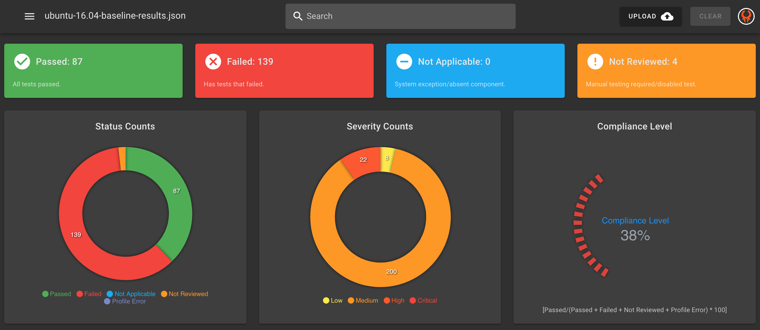
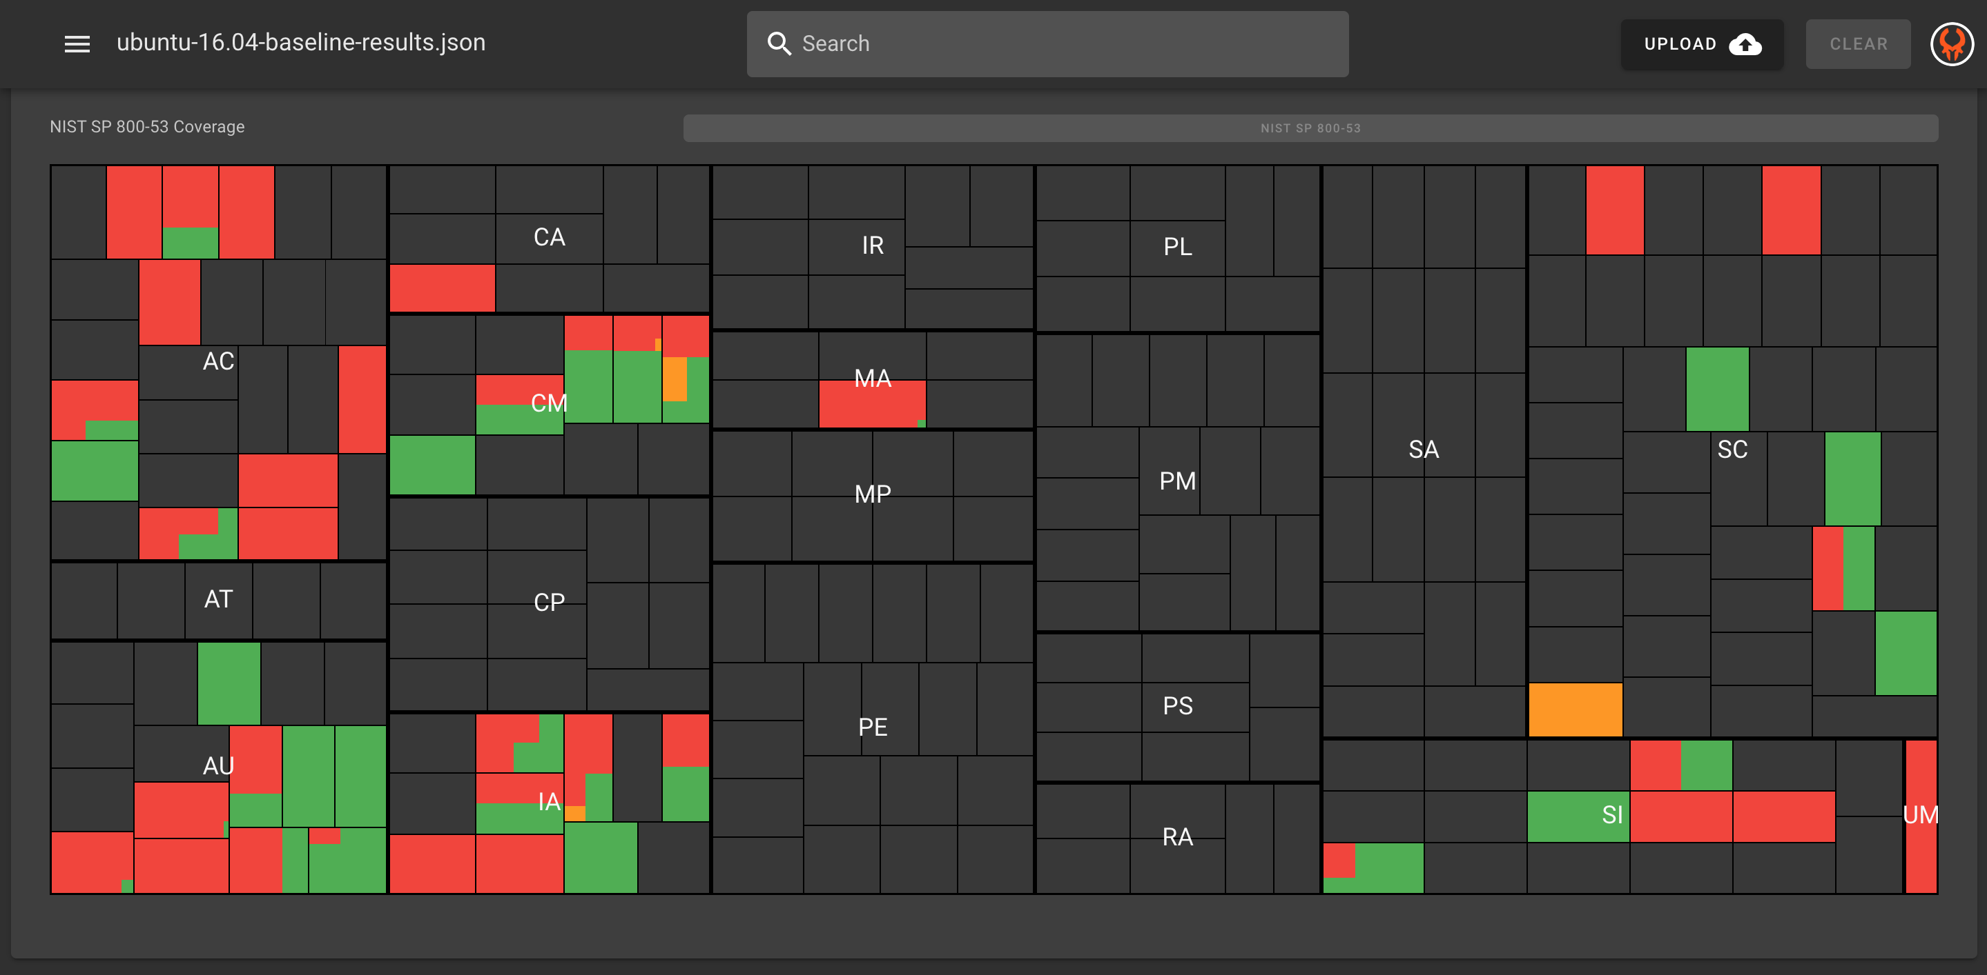
Heimdall – Summary and Graphical Views
Data Viewing Tools
Visualization of InSpec Results
Mapping to the NIST 800-53 Control Families
Easy Auditing & Communication Between Teams
Quickly See Overall Changes
https://mitre.github.io/heimdall-lite/ and https://github.com/mitre/heimdall

Slide 37
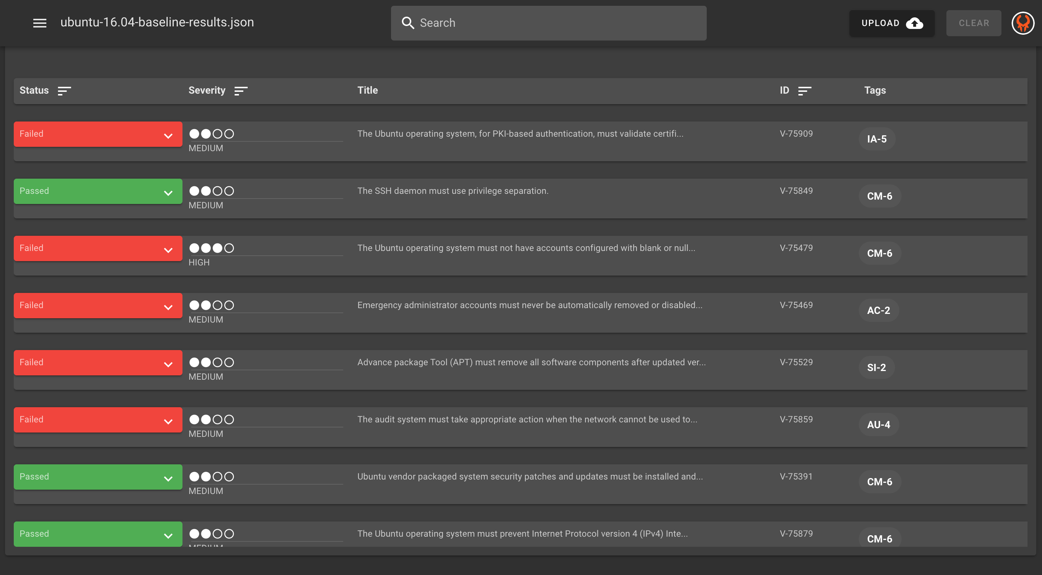
Heimdall – Test Results List View
Data Viewing Tools
Clear Review of Results
Quickly Sort on Keywords, Status or Control Family
NIST Control Details Panel for Reference
Review of the InSpec Code
https://mitre.github.io/heimdall-lite/

Slide 38
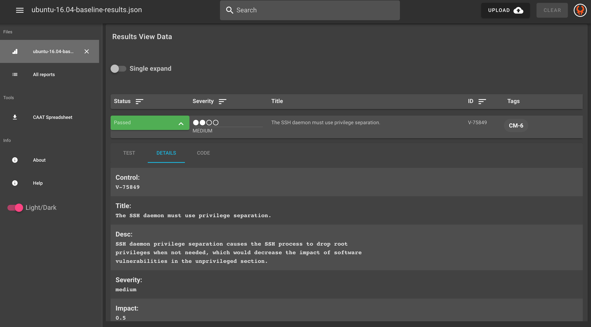
Heimdall – Details View
Data Viewing Tools
JSON allows the start at automated System Security Plan Content
Machine Readable Results allow one to adjust the data to each of your Systems
https://mitre.github.io/heimdall-lite/

Slide 39
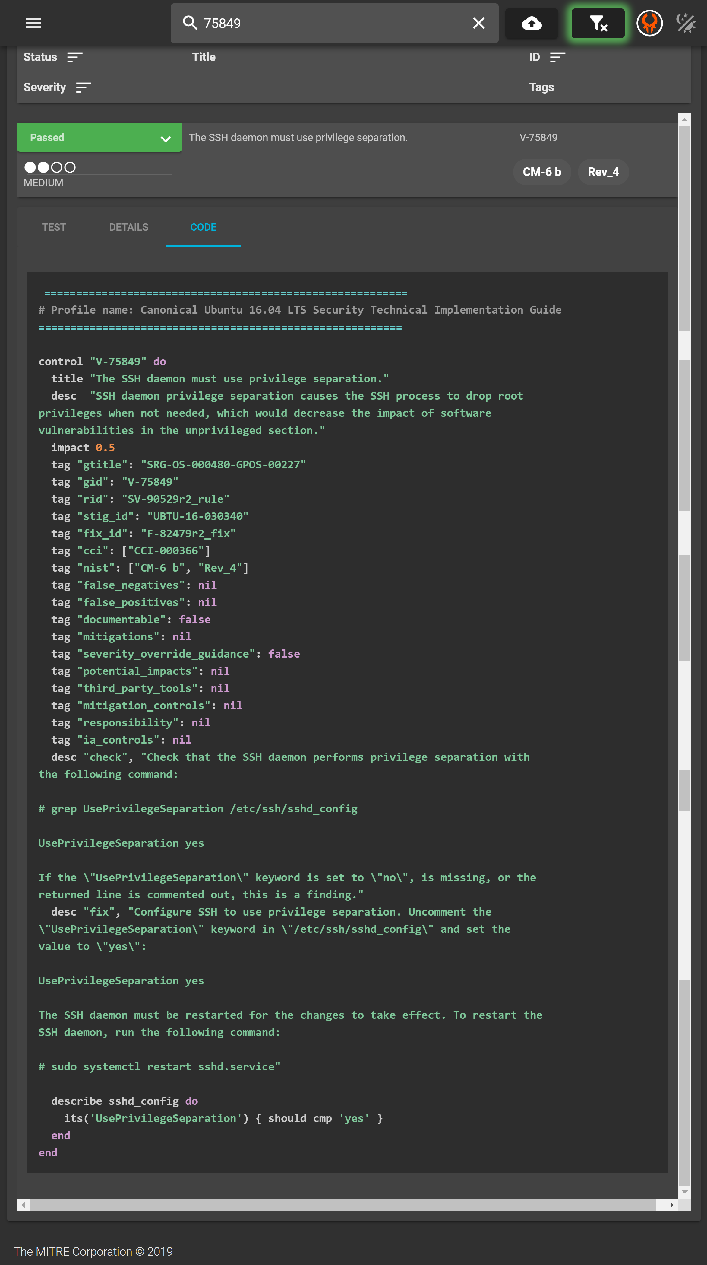
Heimdall – InSpec Profile Code View
Data Viewing Tools

Slide 40
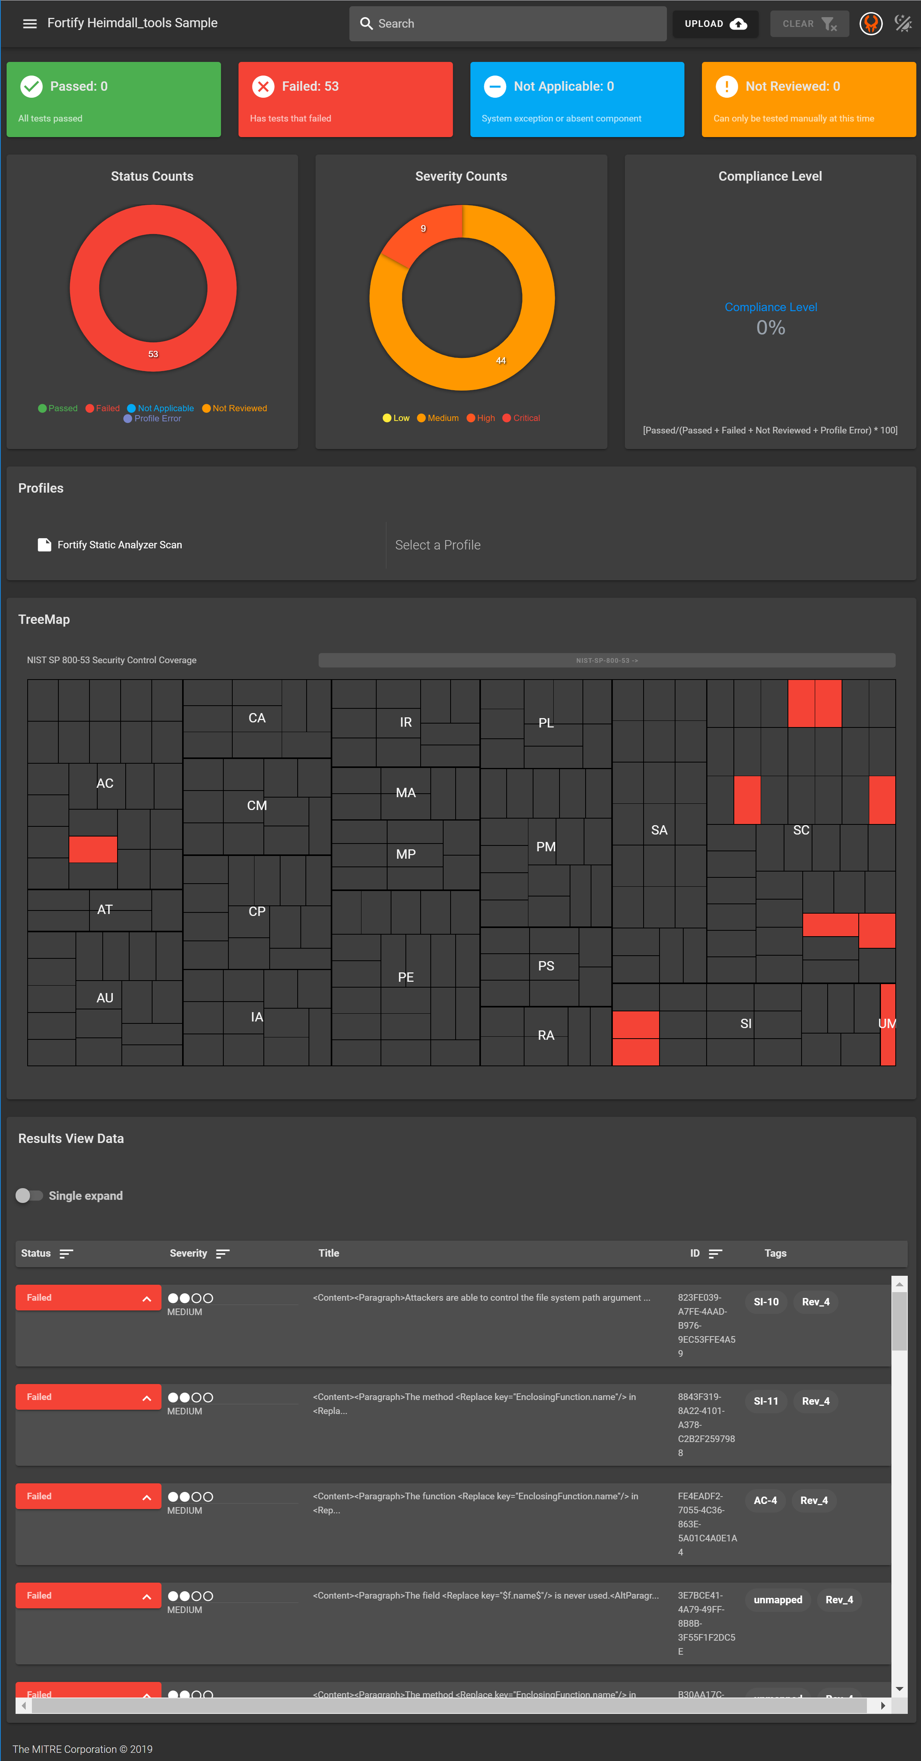
Heimdall – Static Code Analysis Tool View
Data Viewing Tools

Slide 41
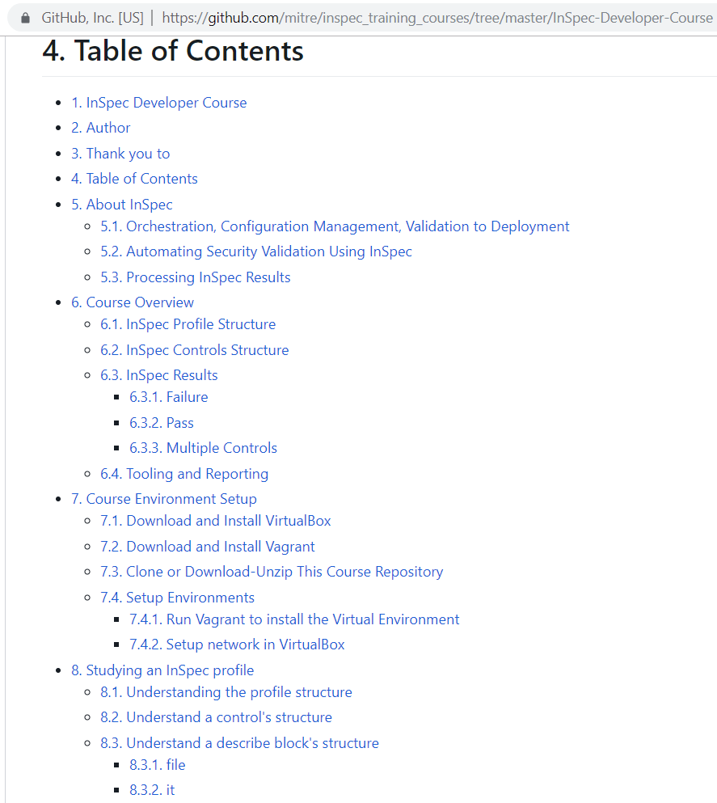
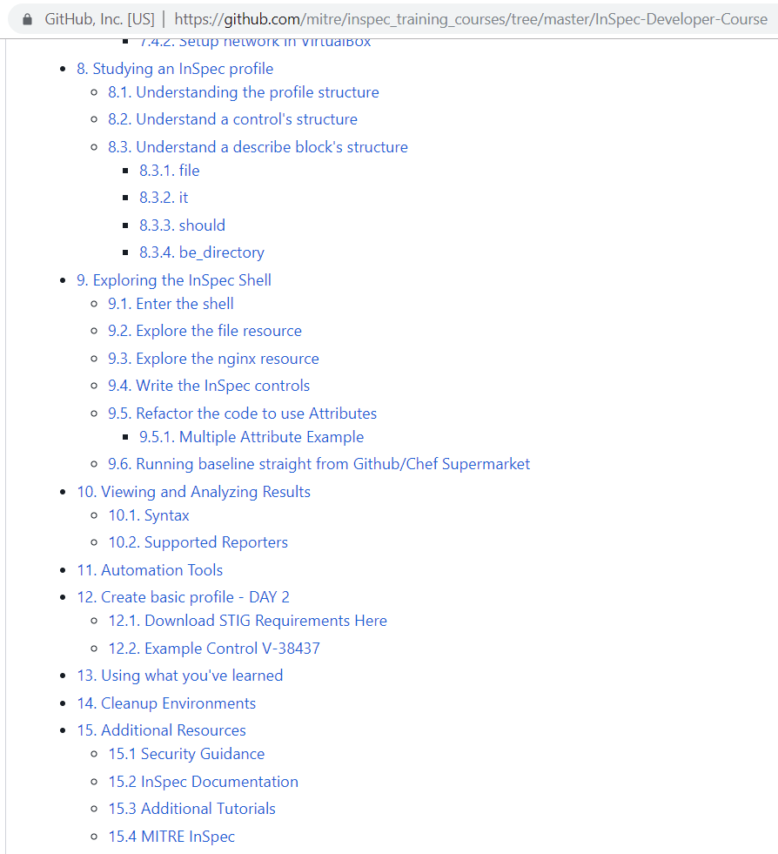
Helping to Build an InSpec Community
https://github.com/mitre/inspec_training_courses/tree/master/InSpec-Developer-Course

Slide 42
Security Documentation as code devsecops best practice focus area

Slide 43
Security Documentation as Code Best Practice
This focus area uses the pipeline to directly perform security validation tests.
For example, InSpec profiles include documentation for each security test they perform, and hence provide the context of each successful security check they perform.
Each security check is also linked to a NIST SP 800-53 control.
A DevOps team can use this data, grouped by security control, to help populate or supplement private implementation details in the SSP.
For example, the Heimdall viewer provides a different view of the JSON data output for SSP-ready use:

Slide 44
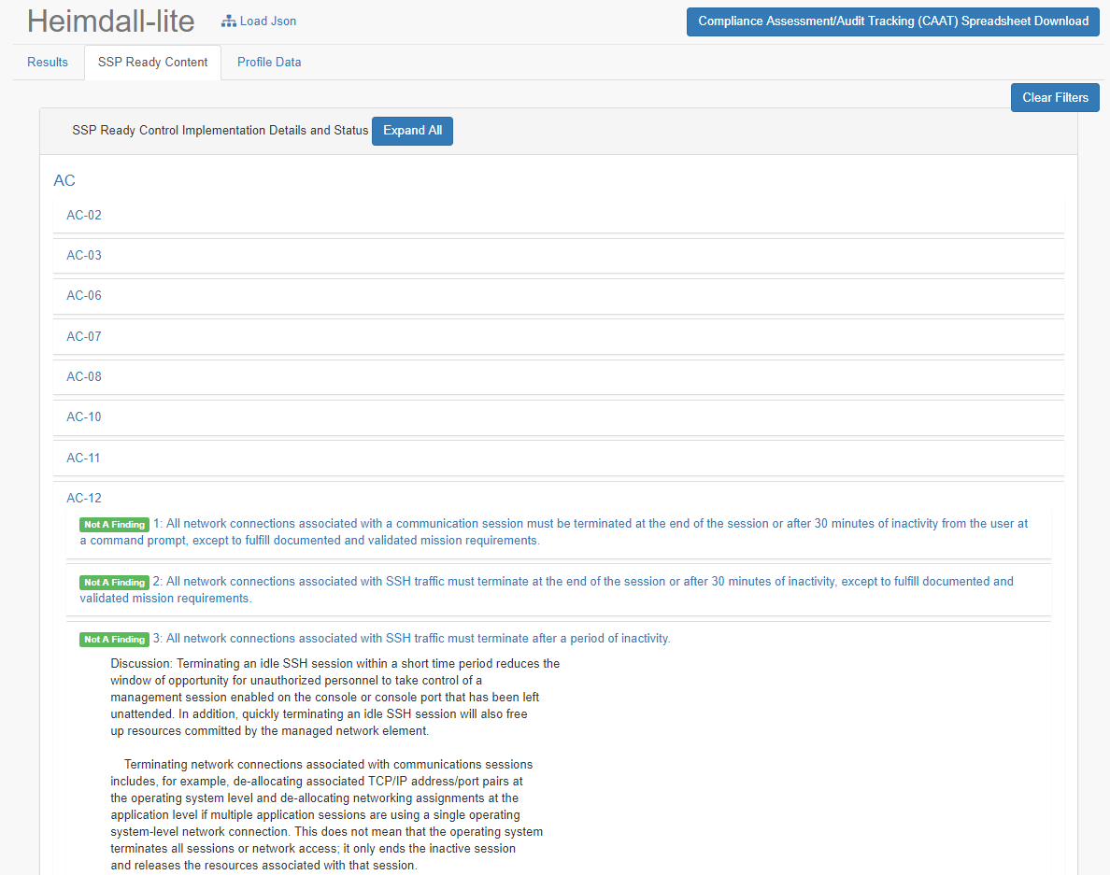
The Tech: Using InSpec for Security Documentation
Transparency and visibility into control implementation details in DevOps environments

Slide 45
Change management auditing devsecops best practice focus area

Slide 46
Change Management Auditing
Plan
Commit
Build
Unit Test
Deploy
Test
Production
Application Code
Orchestration Server used to Create, Configure, and Validate
Create/ Configure
Web Server
Project Issue Tracking Tool
Source Code Repository
Commit
Job
Application Server
Database
Logs
Containers
Logs
Logs
Logs
Operating Systems
Network Components
Cloud Services
Change Management Auditing
SIEM Tools
What’s Changed?
(Architecture Changes for the SIA*)
* SIA – Security Impact Analysis, required for each sprint

Slide 47
Security control coverage for current devsecops best practice focus areas

Slide 48
Security Control Coverage when Building Security into DevOps
Security Validation as Code supports | SA-11 – Developer Security Testing and Evaluation
Security Documentation as Code supports | SA-5 - Information System Documentation
… for a range of security controls on Cloud (e.g., AWS), OS (e.g., Red Hat), Web (e.g., NGINX), or Database (e.g., PostgreSQL):
Change Management Auditing supports
CM-3 - Configuration Change Control
SA-10 - Developer Configuration Management
CM-4 - Security Impact Analysis
CM-5(2) - Review System Changes
IR-6(1) - Automated (Incident) Reporting

Slide 49
Process/Tool Landscape of current devsecops best practice focus areas

Slide 50

Enterprise Guidance: DevSecOps Process/Tool Support Landscape
| 50 |
Planning
Development
Validation
Production
NIST OSCAL
Framework
Security Req Plan Details
SSP
FISMA SOR
Ongoing Authorization Questions
Control Inheritance
Automated Testing
Control Item-level
Continuous Monitoring Plan
Capability focus?
Org Policy
OSCAL
Docs
Reqs to Assess
ISSO workflow tracks status of requirements
Developers + ISSO
ISSO + Developers
Automated Test Results
Manual Tests
Manual Test Results
InSpec Tools
CSP/GSS
Info
CVE Test Tools
InSpec Profiles
Patch
Status
CSP/GSS CDM Capabilities
CSP/GSS CDM Capabilities
CSP/GSS CDM Capabilities
Inventory and Change Management Information
Testing Content
Automated Test Results
SIEM CDM Data Views
SIEM CDM Data Views
SIEM CDM Data Views
InSpec
Heimdall Application Toolchain
Heimdall Enterprise Server
Assessment
Tracking Spreadsheet
Static Code
Analysis Tools
Automated Test Results
Heimdall
Lite
Sprint/Dev-level
Security Visibility
& Debt Reduction
Heimdall
Team Server
Sprint/Val-level
Security Visibility
& Debt Reduction
Heimdall
Team Server
Sprint/Prod-level
Security Visibility
& Debt Reduction
Dynamic Code
Analysis Tools
Developers
Developers + ISSO + Business Owner
Developers + ISSO + Business Owner
Auditor
Developers + ISSO + Business Owner
SOC Analyst
Sandbox
Development
Validation
Production
Notes:
To recap in a different way, I'm not going to walk through all of this, but feel free to get back to Brett and myself on how all of these tools and processes work together across all environments from concept through to production and FISMA reporting.
We are starting to see progress across the development lifecycle and mapping efforts from across multiple teams to coordinate and deliver specific products that help the sponsor build security into their DevOps pipelines. It’s complicated, but we are breaking it down into specific deliverables.

Slide 51
Future devsecops best practice focus areas

Slide 52
Reporting Future devsecops best practice focus area

Slide 53
ISSO Reporting
The ISSO is responsible for tracking of security defects that cannot be resolved before the end of each Sprint
A standard method for populating any kind of security finding, be it from InSpec, static or dynamic code analysis, penetration testing, or external auditors:
Record these in some type of Compliance Assessment/Audit Tracking (CAAT) spreadsheet
For example, Heimdall provides a means for the ISSO to generate this spreadsheet…

Slide 54
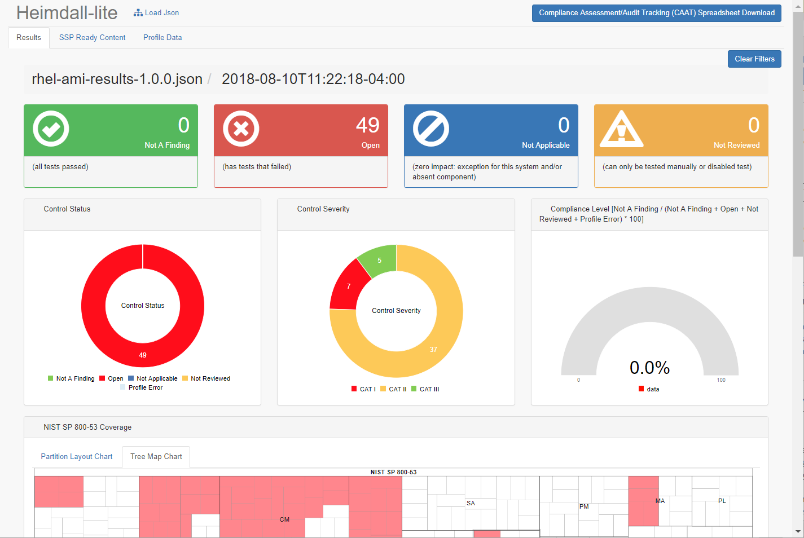
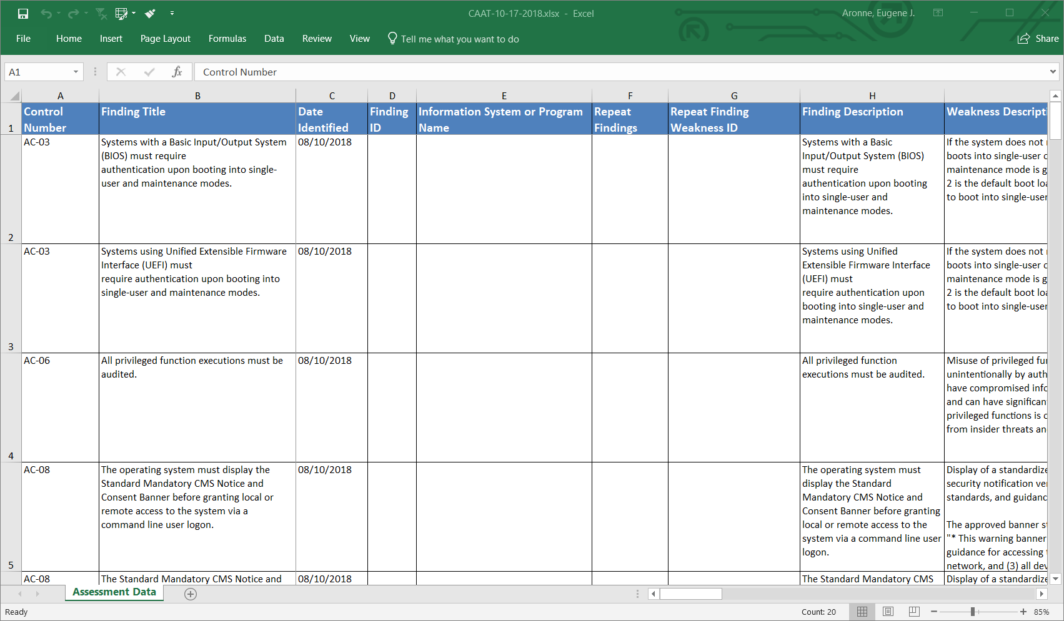
Heimdall – CAAT File Generation (ISSO Reporting)

Slide 55
Security Control Assessment Reporting
Security Control Assessment teams perform security assessments for the initial authorization of a system and ongoing authorization after the initial authorization.
A proposed best practice is for these teams is to review security data coming from the DevOps environments, to supplement or reduce the time-consuming process of introducing external security tools to perform assessments.
Open source examples include using Heimdall or CAAT options

Slide 56
DevSecOps Support for Initial and Ongoing Authorization
Automated DevSecOps Pipeline
Security Data
Security Data
Security Data
Security Data
Helps provide Data for Initial ATO
Sprint 1
Go-No Go
Decision
Sprint 2
Go-No Go
Decision
Sprint N
Go-No Go
Decision
Helps Maintain ATO Going Forward after Initial ATO

Slide 57
SOC Reporting
The security operations center (SOC) team monitors security across the enterprise, performing threat modeling and alerting system developers and maintainers when threats are detected targeting vulnerable systems.
The SOC needs to be aware of the security vulnerabilities of systems.
A proposed best practice for the SOC is to review security data from DevOps environments by using a Heimdall server enterprise-level viewing capability.

Slide 58
Operational analytics Future devsecops best practice focus area

Slide 59
Security in DevOps Operational Analytics Future Focus Area
The DevOps teams should work with all stakeholders to develop a best practice process to engineer application audit log triggers during development to detect anomalies during operations and use this data to adapt to and plan for the next application development Sprint:
Operational Analytics
Original “Infinity Loop” Graphic Source: Gartner - DevSecOps

Slide 60
Security in DevOps Operational Analytics Future Focus Area
The intent for this best practice is for DevOps teams to work with the business owner to define unusual business-application usage patterns to base security event triggers, leveraging web, api, and application server logs.
Unusual usage patterns are highly dependent on the specific business workflow and use cases for their application.
These patterns could be unusual transactions, deletions, downloads of unusual volumes or types data given a user’s defined role for the application, etc.
Custom code may be required to generate many of these business application-specific events.
The intent is for the DevOps team to collect these audit logs and configure an SIEM to detect and alert the DevOps team of these anomalies.

Slide 61
Process improvement Future devsecops best practice focus area

Slide 62
Security in DevOps DevSecOps Cycle Improvement (using Metrics)
The DevOps teams should work with all stakeholders to describe what to measure and how to analyze the data to constantly improve the project’s DevSecOps process. It will improve future builds using metrics and measures of security debt, unauthorized changes during development, and detection of anomalies during operation:
DevSecOps Process Improvement (using Metrics)
Original “Infinity Loop” Graphic Source: Gartner - DevSecOps

Slide 63
Security in DevOps DevSecOps Cycle Improvement (using Metrics)
Initial proposed metrics include:
All high security defects and 90% of all medium or low security defects are resolved before allowing affected functionality to be deployed to production.
No security defect may carry-over unresolved through more than 2 Sprints.
The number of unplanned (unauthorized) changes for any Sprint is less than 5% of the number of planned (authorized) changes.
This best practice should be refined through continued work with internal and external DevOps teams, including industry best practice research such as the DORA (DevOps Research and Assessment).
https://devops-research.com/

